Slide 1
COVID-19’s Impact on the Real Estate Industry: A Zillow Analysis
Laura Magallanes, Rob Huibregtse,
Jane Hedges, James Pelletier

Slide 2
Objective & Scope
Project Objective: Anecdotally, the COVID-19 pandemic and the resulting increase in work-from-home employment is said to have created a shift in the housing market by taking some air out of the market in large cities and increasing housing demand in smaller cities across the country. By analyzing data provided by Zillow regarding home values, rent, inventory, and market demand, from pre-pandemic through post-pandemic years, we aim to visualize and draw some conclusions about the magnitude of this change in the housing market.
Scope: The project analysis will be sourced from Zillow’s real estate databases and conducted on a nationwide scale during the time period of 2018-2023, highlighting pre-pandemic, pandemic, and post-pandemic periods. The key metrics we aim to focus on are: Inventory Levels, Market Heat Index, Rent Index, and Home Value Index.

Slide 3
Zillow Data Collection
We used Zillow’s data on four key metrics, broken down by metro area and ranked by size.
Metrics:
Housing Inventory
Home Value Index
Rent Index
Market Heat Index
939 total metro areas recognized by Zillow
Most data only does back to 2018

Slide 4
Hypotheses & Research Questions
Hypothesis 1: Larger Cities experienced an increase in inventory compared to smaller cities due to individuals moving from larger cities to more remote locations during the pandemic period (2020-2021).
Ho: Larger cities do not experience a significant increase in inventory compared to smaller cities during the pandemic period (2020-2021).
Ha: Larger cities experienced a significant increase in inventory compared to smaller cities during the pandemic period (2020-2021).
Hypothesis 2: Larger cities experienced a decrease in rent value index compared to smaller cities during the pandemic period (2020-2021)
Ho: Larger cities did not experience a significant decrease in rent value index
Ha: Larger cities did experience a significant decrease in rent value index
Hypothesis 3: Larger Cities experienced a decrease in home value index compared to smaller cities due to individuals moving from larger cities to more remote locations during the pandemic period (2020-2021).
Ho: Larger cities do not experience a significant decrease in home value index.
Ha: Larger cities do experience a significant decrease in home value.
Hypothesis 4: Larger cities experienced a decrease in market heat index compared to smaller cities during the pandemic period (2020-2021)
Ho: Larger cities did not experience a significant decrease in market heat index
Ha: Larger cities did experience a significant decrease in market heat index
Question 1: How did market heat index and interest rates correlate from 2018 - 2023?
Question 2: How did housing inventory change from 2018-2023?
Question 3: How did rent index change in large and small cities between 2018 and 2023?
Question 4: When compared to the rent index in smaller cities between 2020 and 2021, is the decline in the rent index in large cities statistically significant?
Question 5: Is there a statistically significant difference in the measures of central tendency between large and small cities in 2021 compared to 2019?
Question 6: How do inventory index levels compare across different city size segments?
Question 7: Has there been a notable dip in the Home Value Index for in large cities between 2018 - 2023?
Question 8: Have home prices increased at a faster rate in smaller cities compared to large cities?

Slide 5
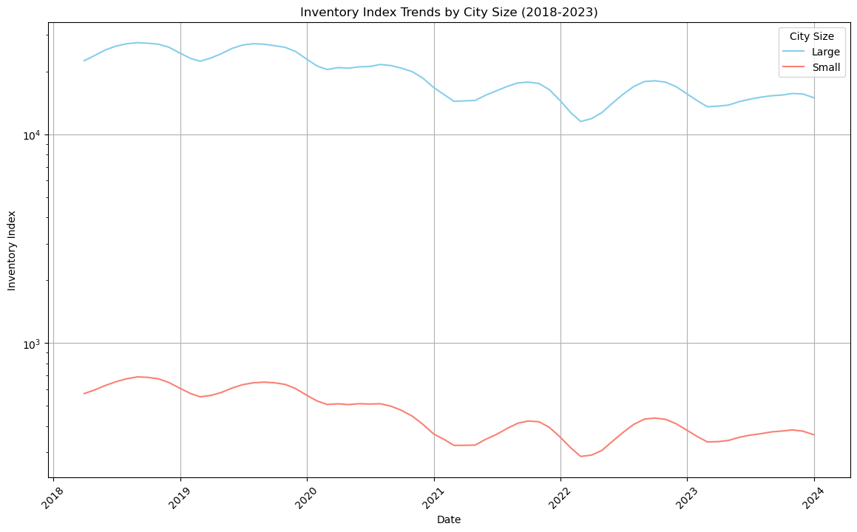
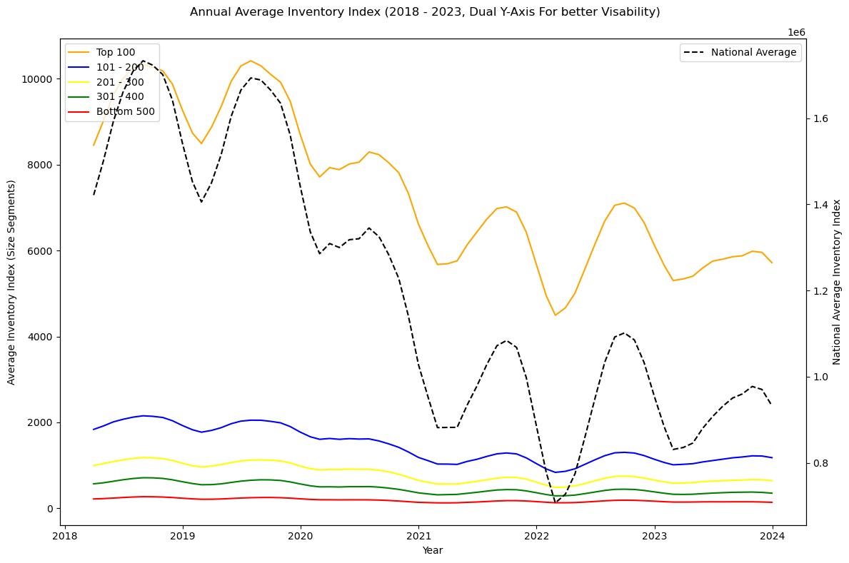
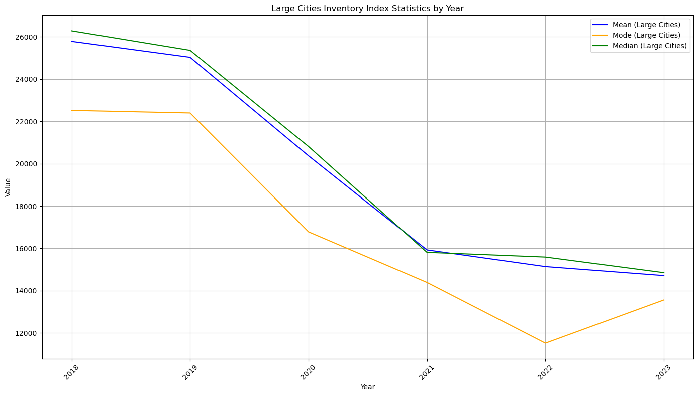
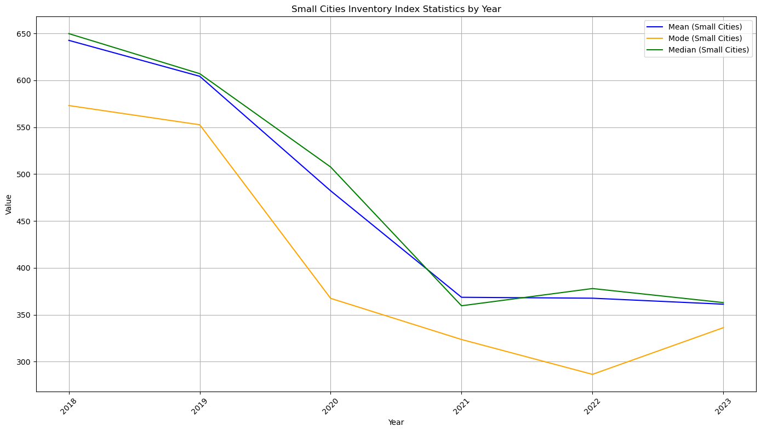
Inventory Index Analysis

Slide 6
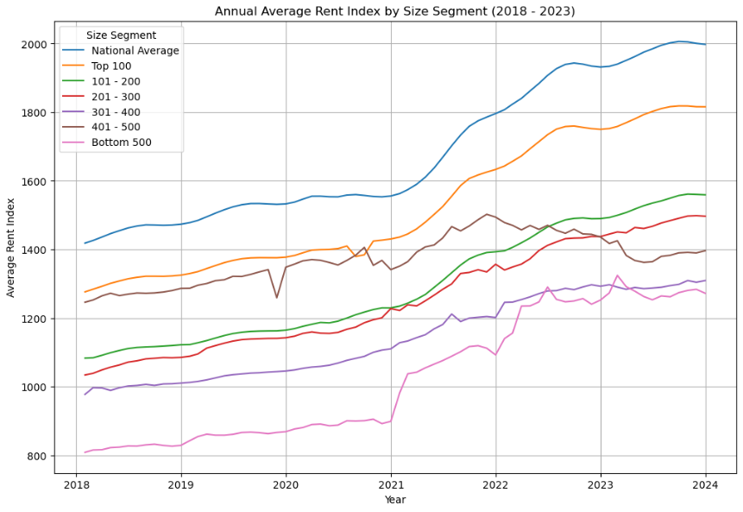
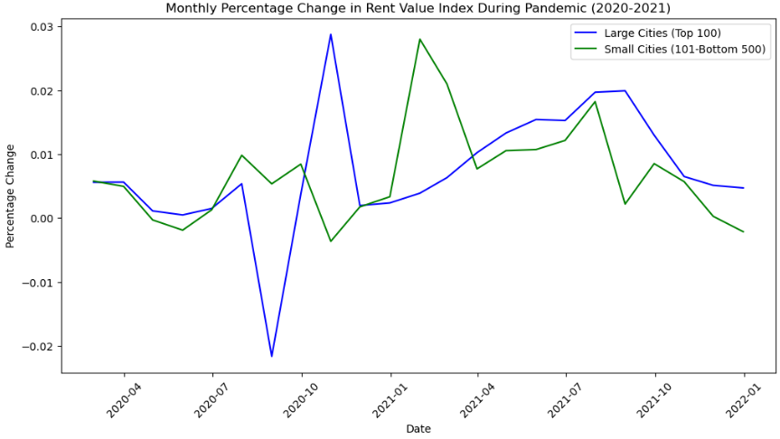
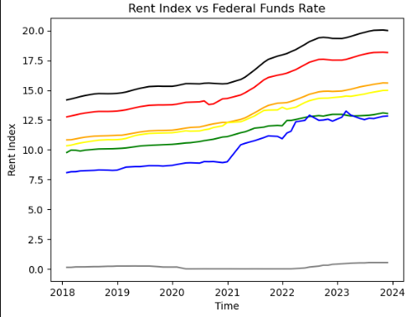
Rent Index Changes

Slide 7
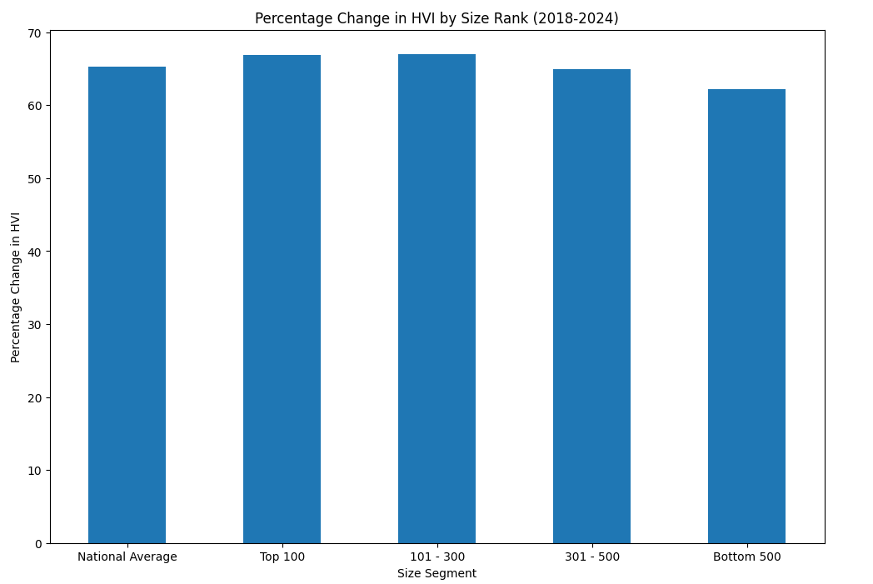
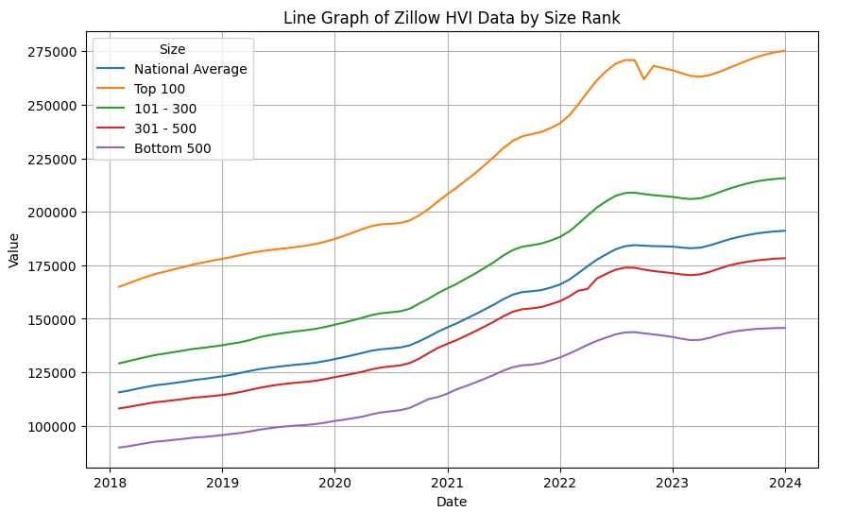
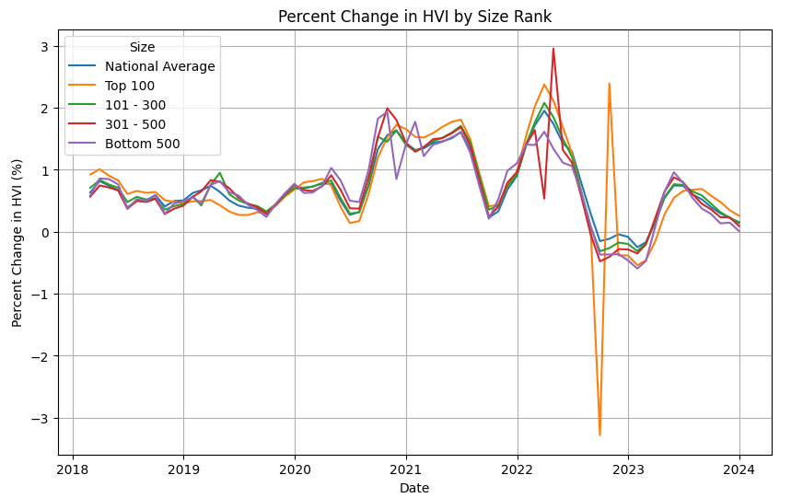
Home Value Index

Slide 8
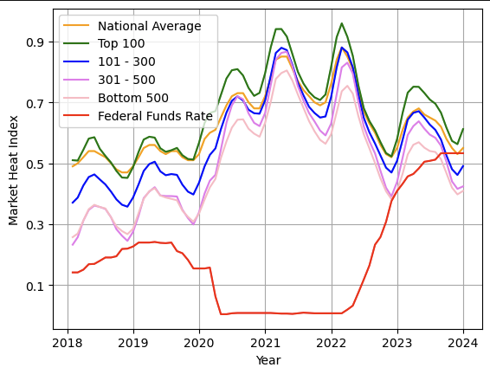
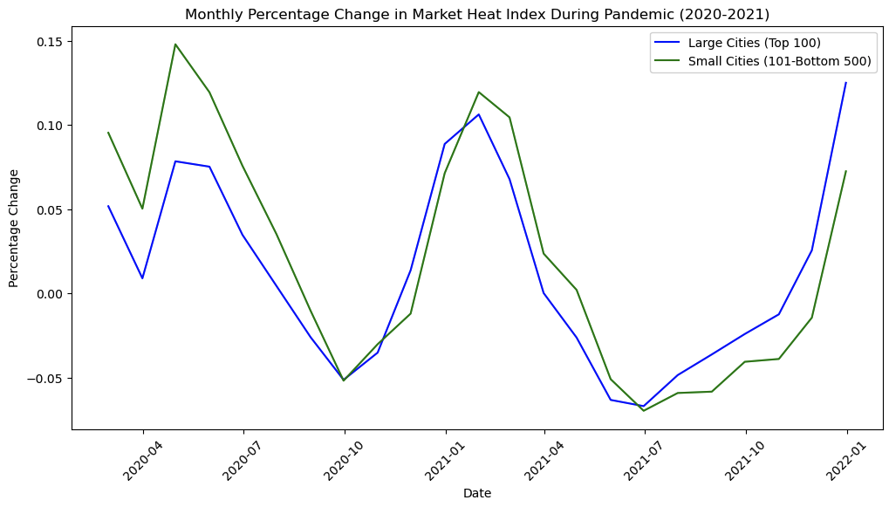
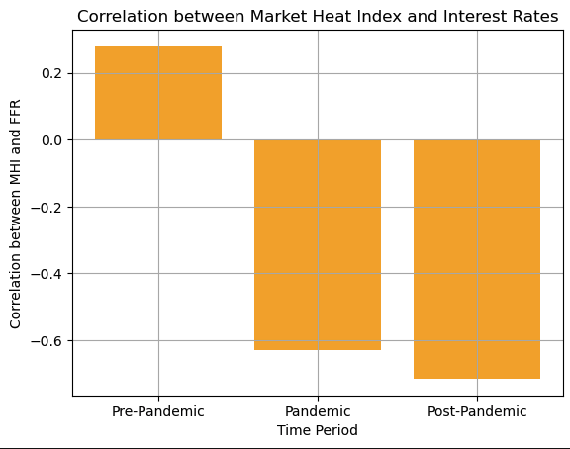
Market Heat Index + Interest Rates
Market Heat Index represents market demand
.5 is neutral, below .5 is low demand, above .5 is high demand
No significant difference between change in demand between size segments
Positive correlation with interest rates before pandemic
When interest rates dropped during pandemic, correlation turned negative

Slide 9
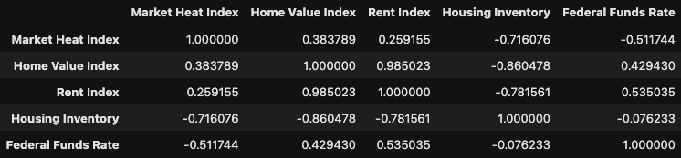
Correlation between all metrics
Strongest Correlation: Home Value Index and Rent Index
Weakest Correlation: Housing Inventory and Federal Funds Rate

Slide 10
Key Findings
We were not able to reject the null hypothesis for any of our metrics - meaning we could not find a significant change in these four metrics between large metro areas and smaller metro areas during the pandemic.
We did observe significant changes in the housing market, though:
Nationwide housing inventory dropped significantly.
Home values and rent (which are strongly correlated) continued to go up.
The Federal Reserve’s use of interest rates to respond to the pandemic appeared effective in the housing market; the once positive correlation between interest rates and demand was reversed, and the two are now negatively correlated again (as basic economics would predict).

Slide 11
Future Research Considerations
Recent reporting suggests an increase in private equity firms buying single-family housing. How could we factor this into the trends in housing inventory?
How do these inventory trends correlate with other economic indicators like housing prices, population growth, or job markets?
How do variations in rent prices across different city sizes compare to other economic indicators like housing indexes or rates of inflation?
How do inventory trends correlate with broader economic conditions, as measured by GDP, unemployment rates, and housing prices?
How do inventory trends differ across urban, suburban, and rural settings?
Our analysis was conducted at the national level - what might we find if we factored in geography?
Analyze a few specific states with the largest metro areas (New York, for example)
Figure out how to correlate geographic distance into changes in housing metrics

Slide 12
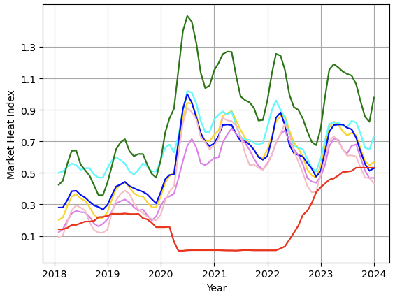
Future Research Consideration
New York State:
Contains largest metro area in the country, New York City
Large hub of finance and tech jobs, which transitioned to WFH models
Early COVID-19 epicenter in America
Also contains many metro areas of different size segments
See graph: Cyan line is New York City, while green line is all other cities in the Zillow Top 100
During the pandemic, demand in other large metro areas in New York drastically increased compared to New York City

Slide 13
Conclusion
Large cities had considerable declines in the rent index during the pandemic, but a p-value of more than 0.05 indicates that the data is not statistically significant.
Large cities and smaller cities both experienced a significant decrease in inventory levels during the pandemic years (2019-2020).
Home prices have risen across the board showing no favoritism for smaller or larger cities.

